Slide 1


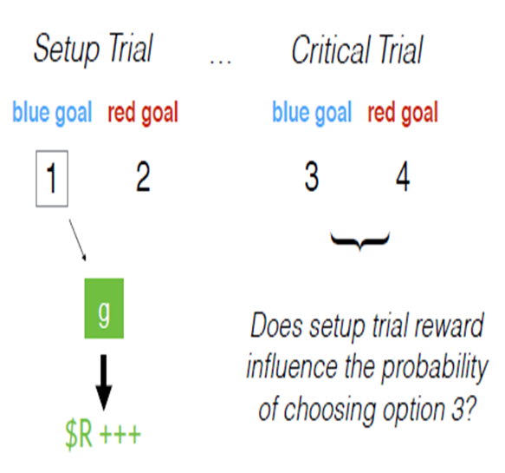
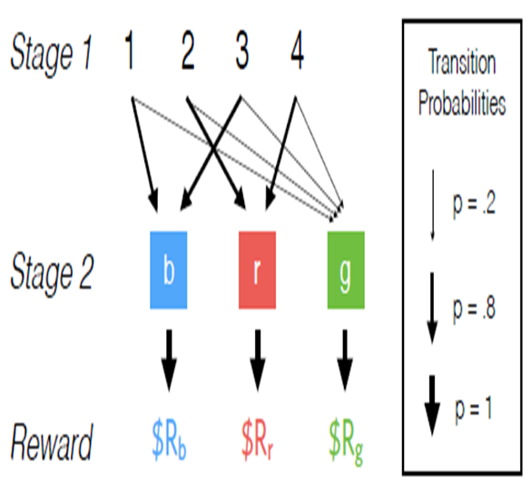
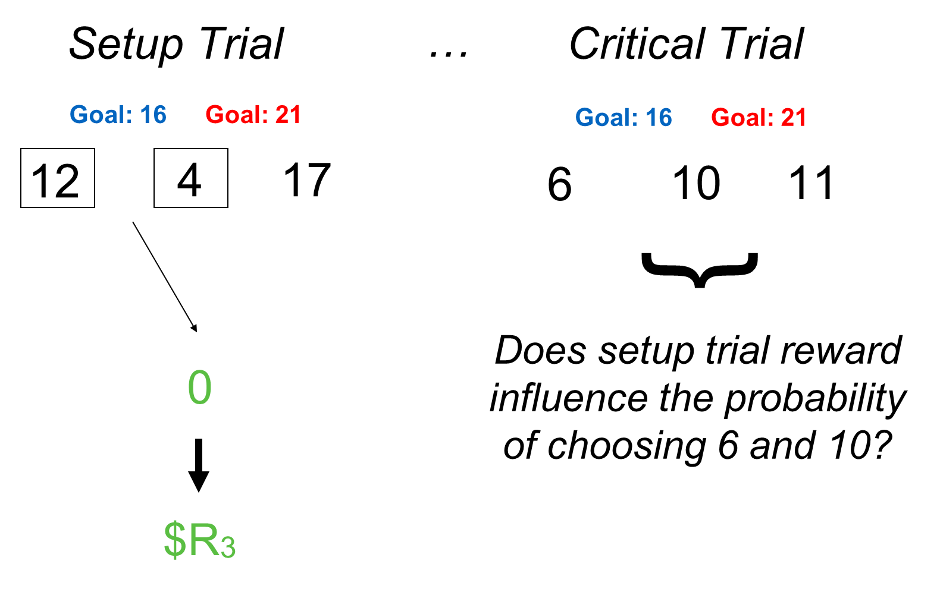
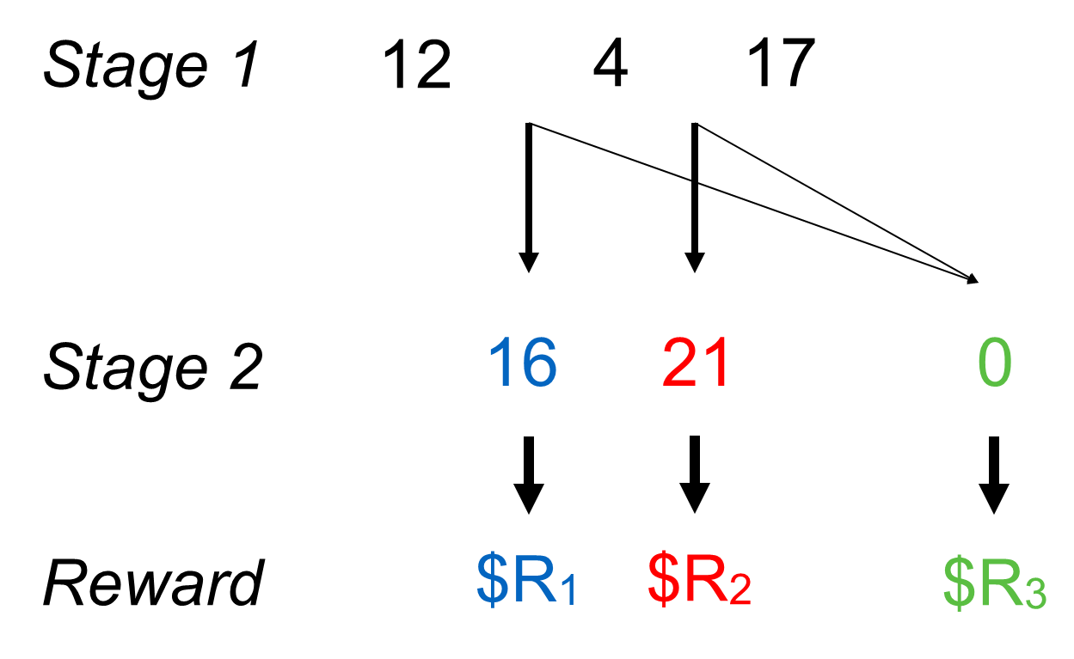
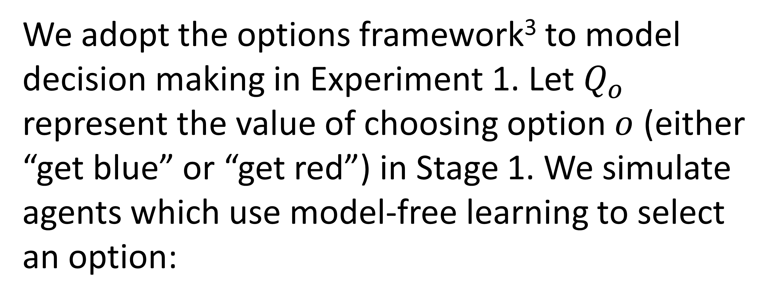
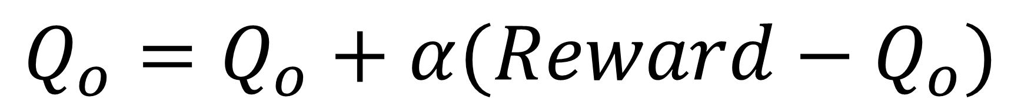
Habitual control of goal selection
Adam Morris & Fiery Cushman
Question
Experiment 1
Decomposing tasks into hierarchical goals/subgoals allows for efficient decision making¹, but choosing goals via exhaustive model-based search is often intractable. How do people select goals efficiently?
Participants performed a two-stage decision task². On critical trials, they experienced a low-probability transition and received a reward; then, they were given the option of choosing a different action with the same goal. A system of model-free goal selection uniquely predicts an increase in that action.
Hypothesis
Goal selection can be under model-free control. People will select goals/subgoals previously associated with reward, independent of the underlying causal structure.
Result: Participants were more likely to select the same-goal action after reward than after punishment.
Experiment 2
Computational Model
Participants chose numbers which summed to one of two goal numbers. On critical trials, they experienced a low-probability transition and received a reward; then, they were presented with novel numbers. A system of model-free goal selection uniquely predicts an increase in selecting the numbers which sum to the previously selected goal.
We adopt the options framework³ to model decision making in Experiment 1. Let $Q_{o}$ represent the value of choosing option $o$ (either “get blue” or “get red”) in Stage 1. We simulate agents which use model-free learning to select an option:
$$Q_{o}=Q_{o}+α(Reward−Q_{o})$$
but model-based planning to choose primitive actions which complete the option. We simulate agents with or without our mechanism.
Result: Our behavioral results only emerge with the inclusion of model-free goal selection.
Result: Participants were more likely to sum to the previously selected goal after reward than after punishment.
References
1. Botvinick, M., & Weinstein, A. (2014). Model-based hierarchical reinforcement learning and human action control.
Conclusions
2. Gläscher, J., Daw, N., Dayan, P., & O'Doherty, J. P. (2010). States versus rewards: dissociable neural prediction error signals underlying model-based and model-free reinforcement learning.
(1) People exhibit model-free control of goal selection.
(2) This mechanism may support efficient goal-directed planning.
3. Sutton, R. S., Precup, D., & Singh, S. (1999). Between MDPs and semi-MDPs: A framework for temporal abstraction in reinforcement learning.
Contact
adam.mtc.morris@gmail.com

